Slide 1


S.P.M English School
Secondary Section
July 2025-26

Slide 2
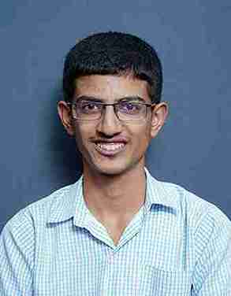
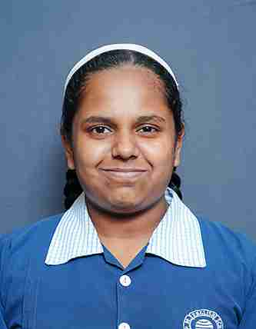
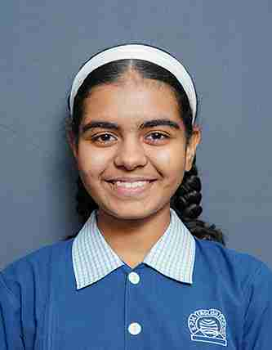
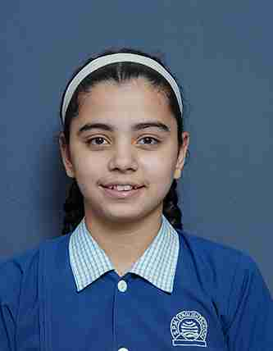

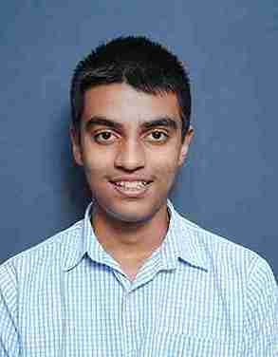
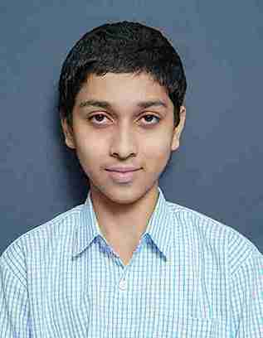

School Toppers S.S.C Board Examination 2024-25
1. Purohit Ishan
2. Bhate Avani
3. Avachat Avani
3. Gadre Anushka
Stars of S.P.M.
4. Shete Malhar
5. Risbood Aditya

Slide 3
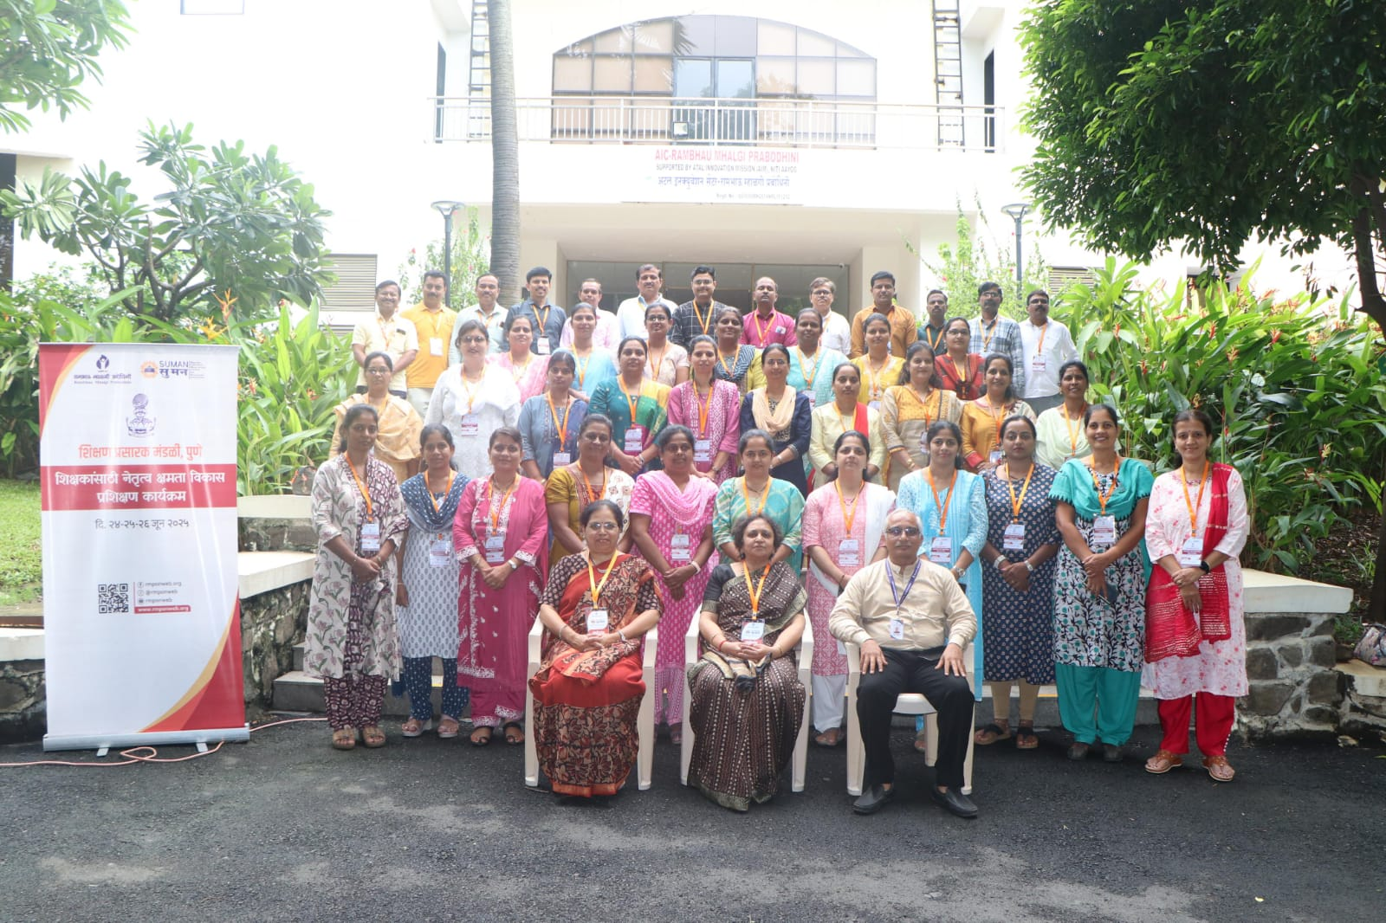
Teacher Training Workshop

Slide 4
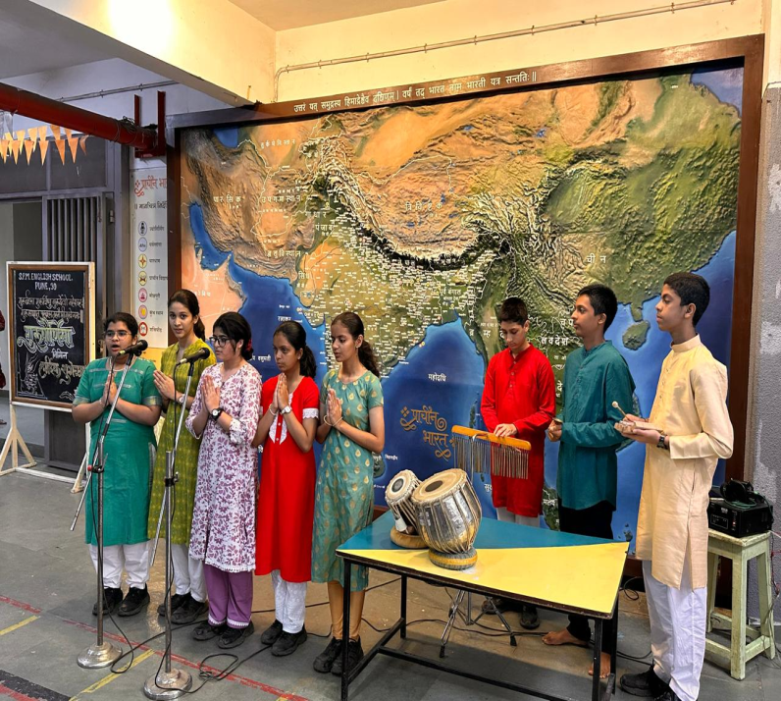
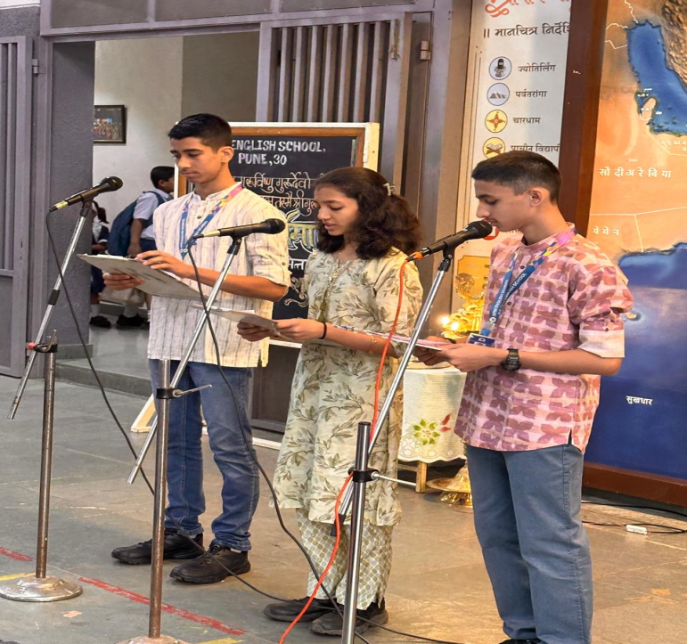
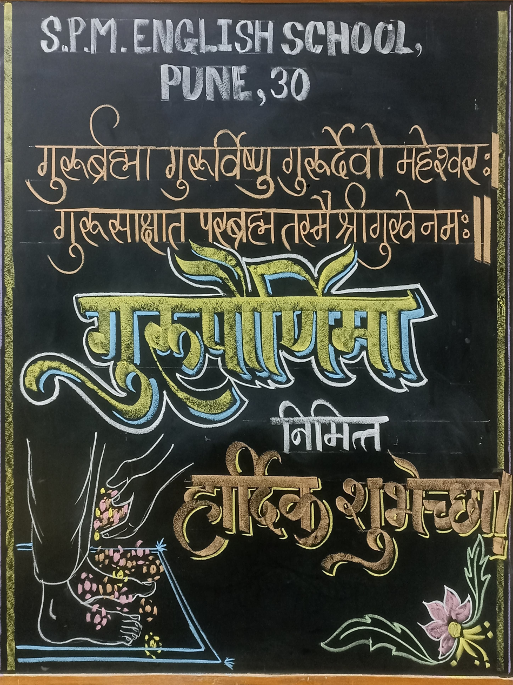
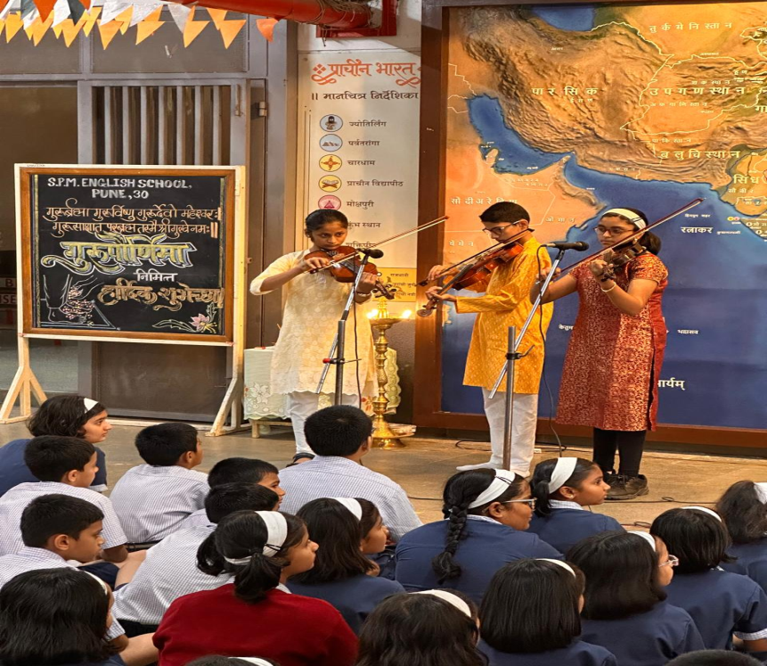
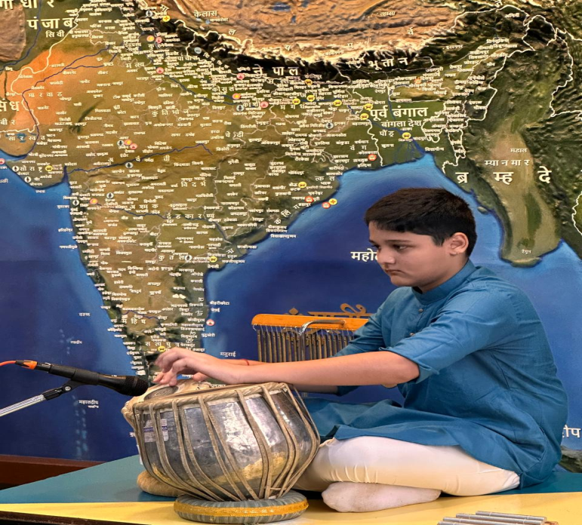
Guru Pournima Celebration

Slide 5
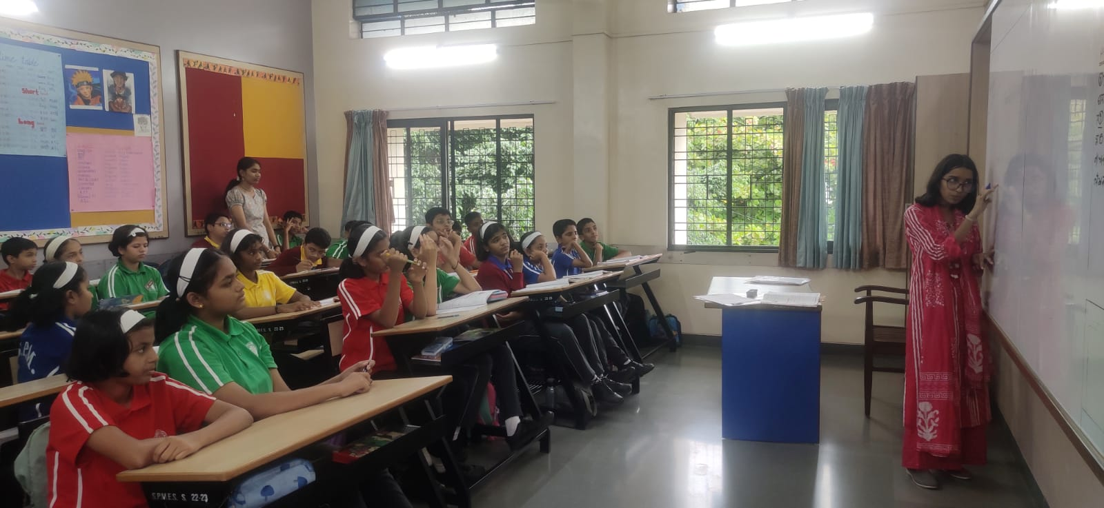
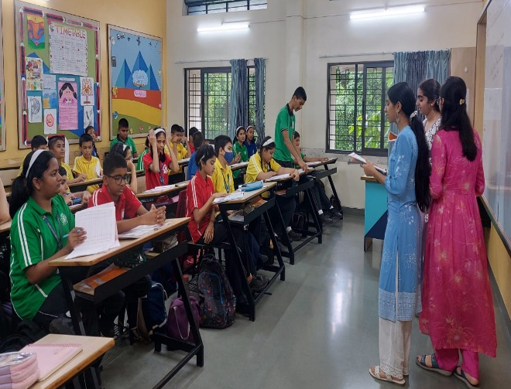
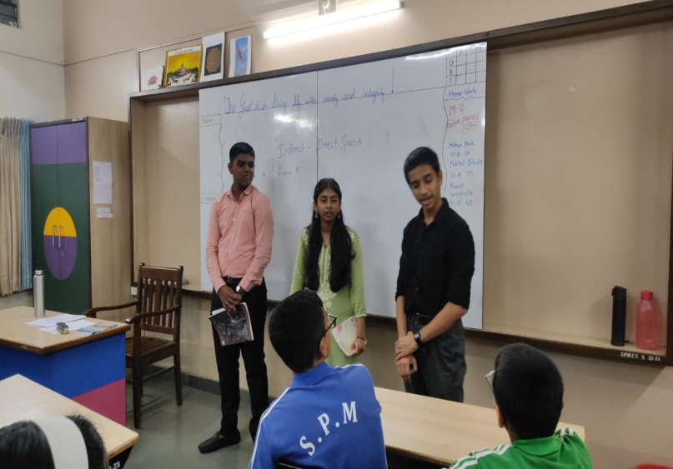
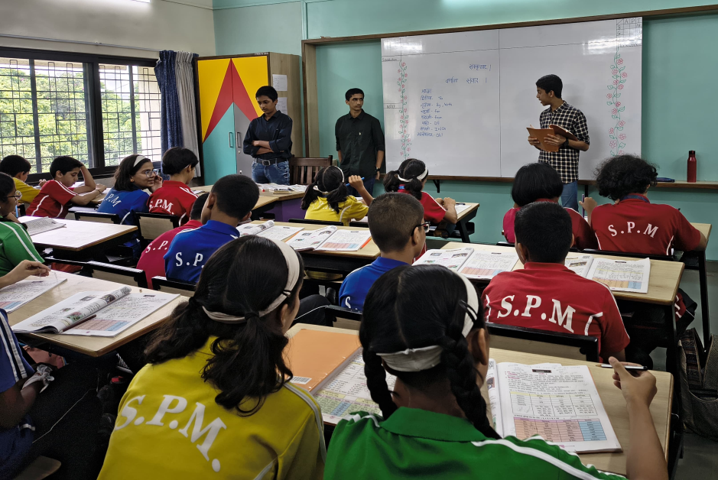
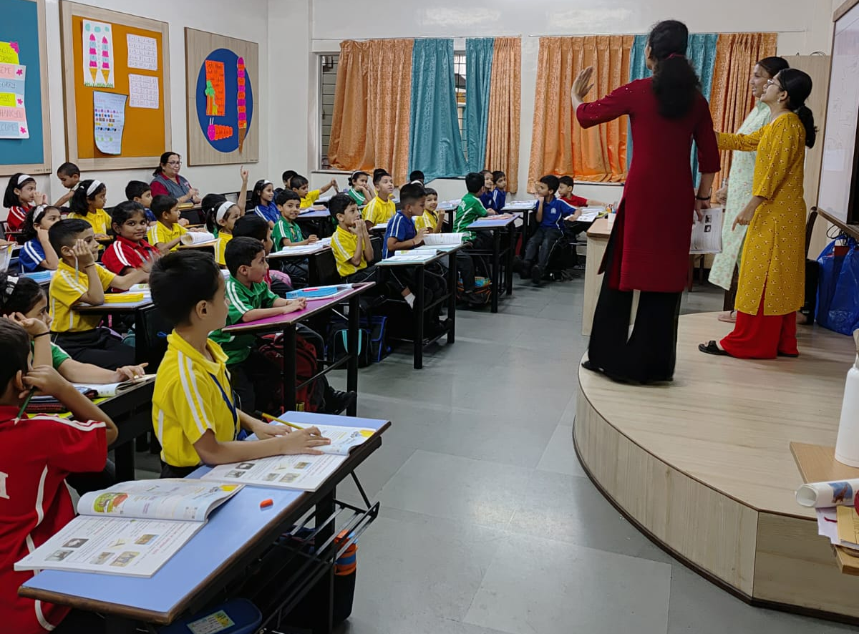
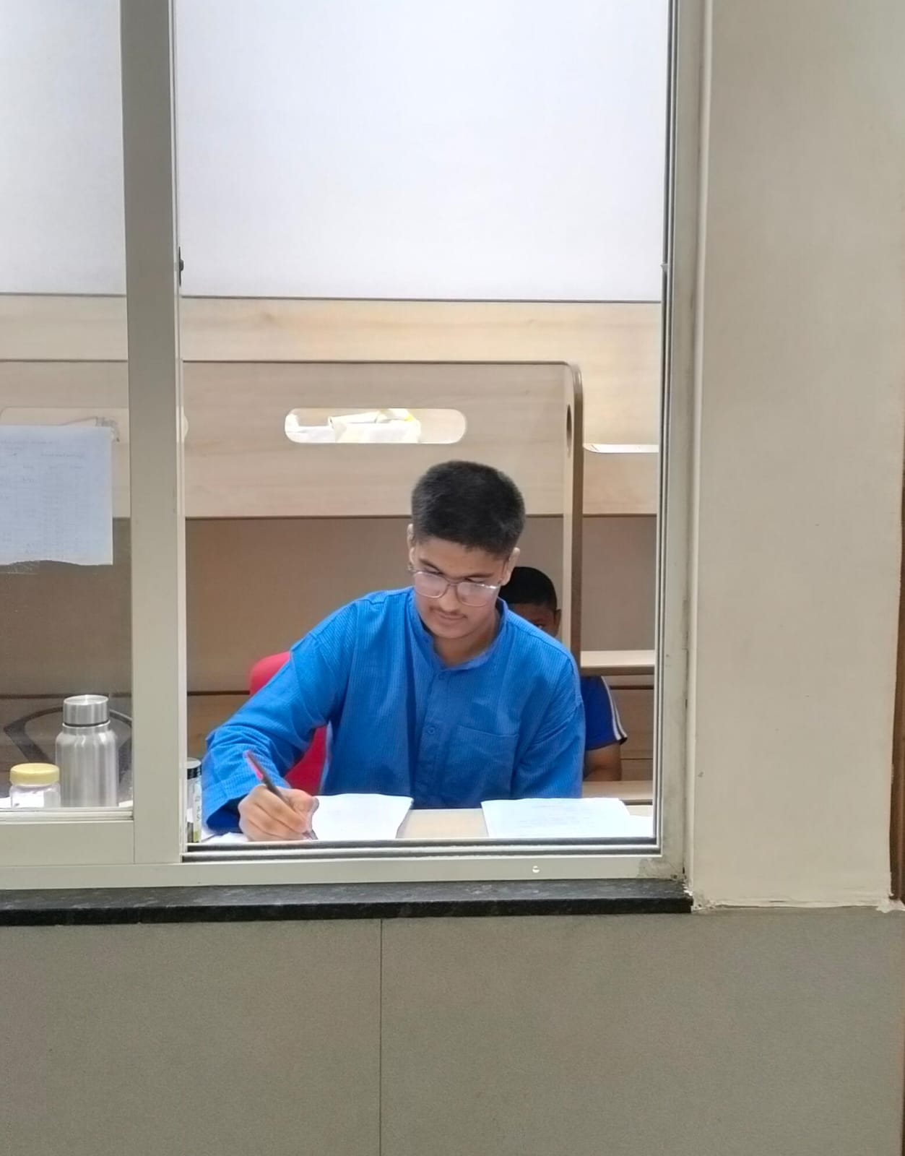
Student Teacher Program

Slide 6
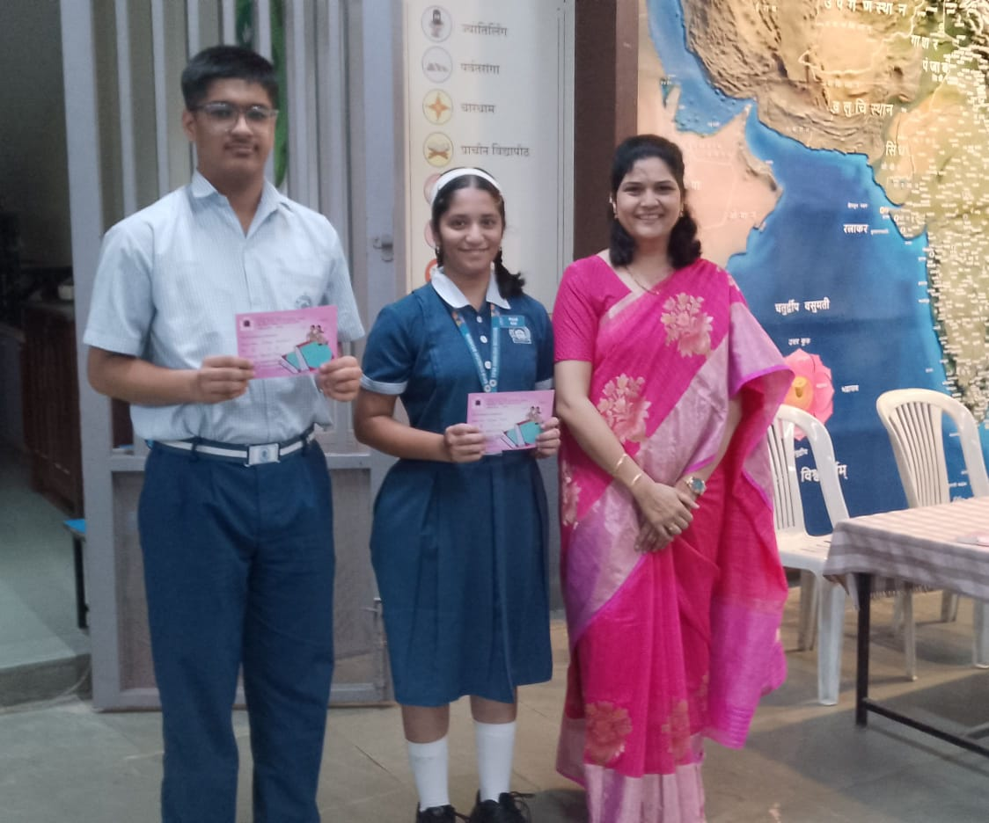
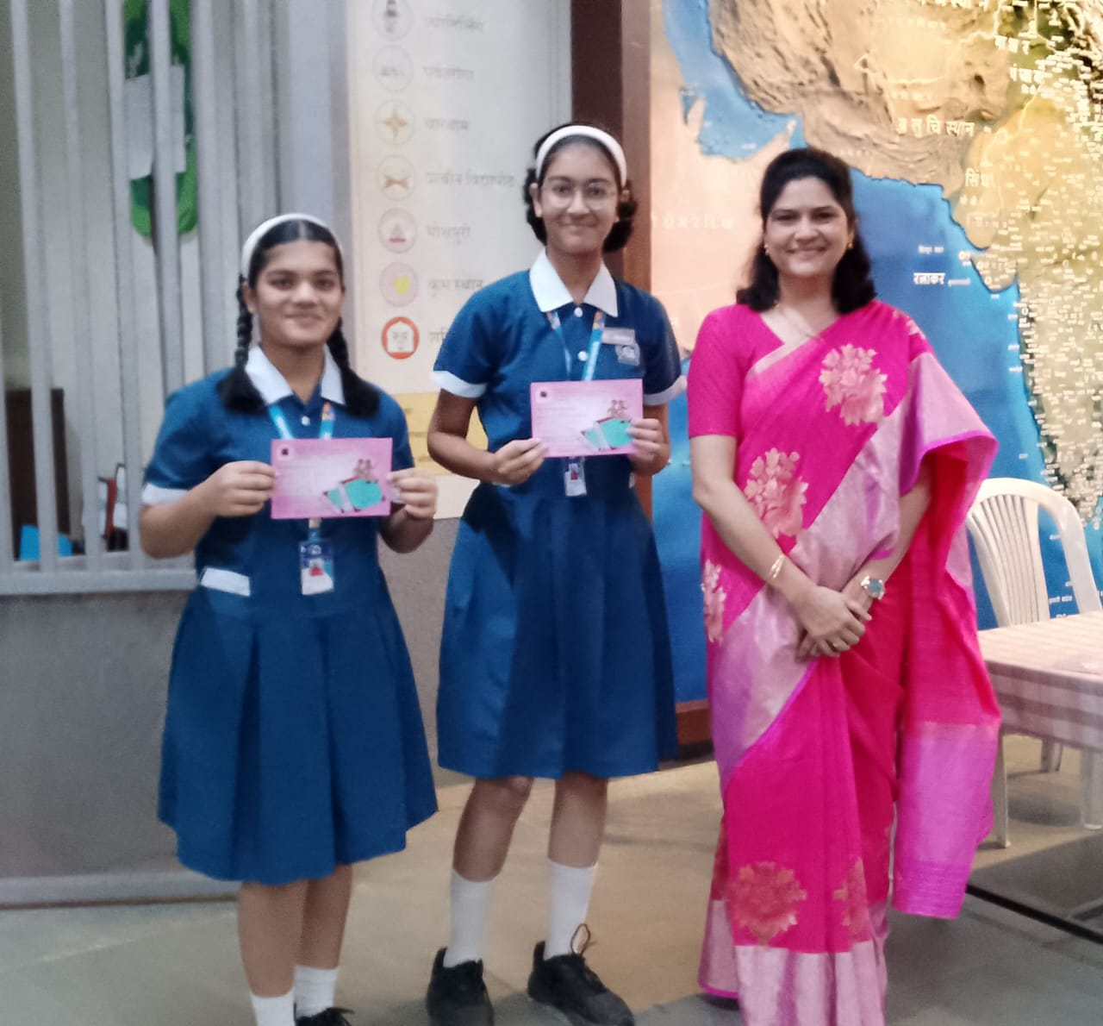
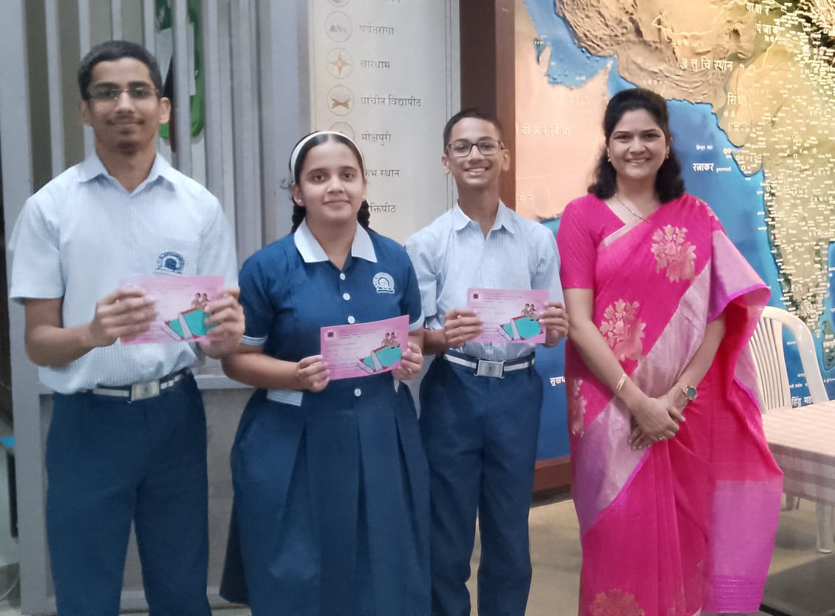
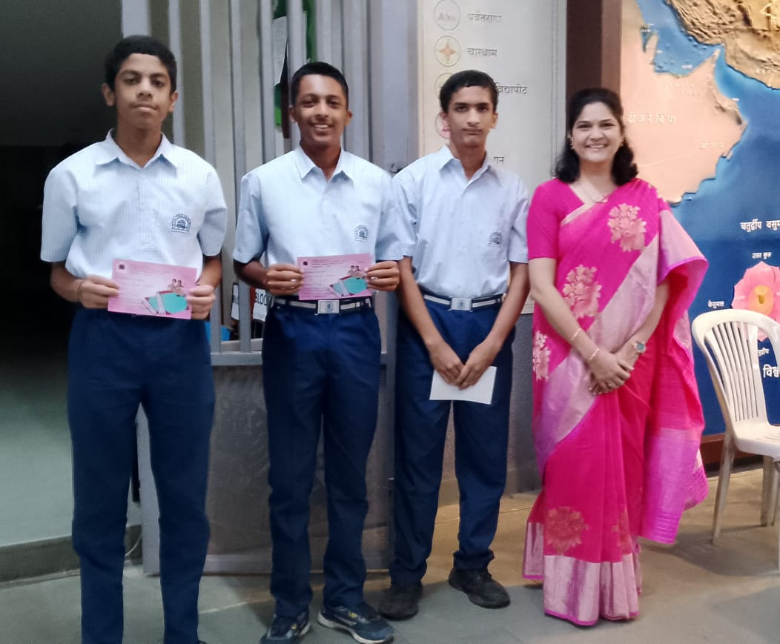
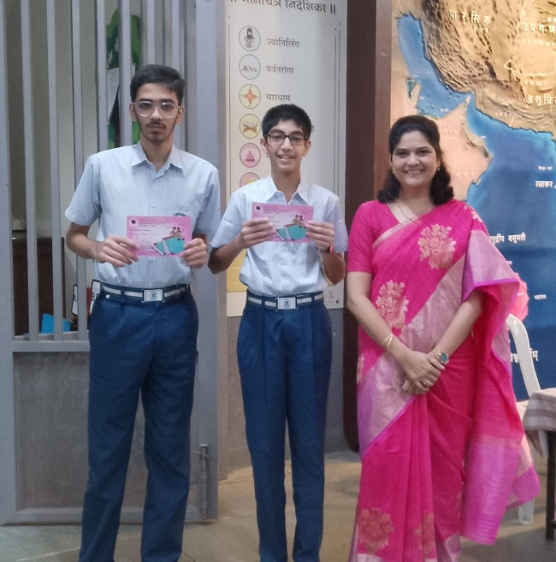
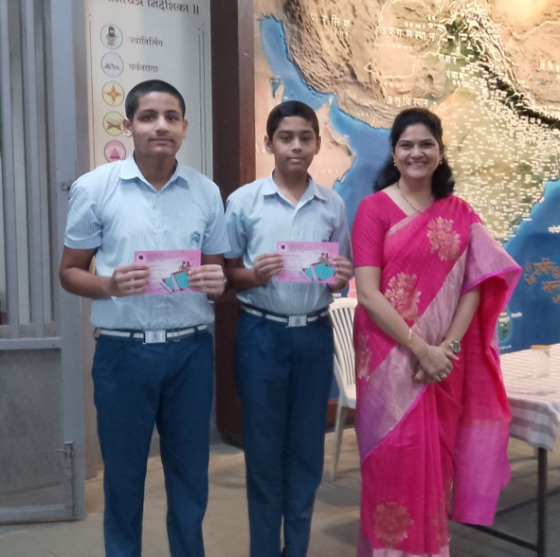
Winners Student Teacher Program

Slide 7

Student Teacher Activity Result
1st Prize | 2nd Prize | 3rd Prize
Arnav Dhobale Mayank Kulkarni Aditya Sathaye | Sharva Deshpande Mihir Kanetkar Amey Kulkarni | Bilva Gandhi Hiranmayee Paranjpe Isha Halbe
First Consolation Prize
Sejal Damle
Anish Ghanpure
Piyush Apte
Second Consolation Prize
Malhar Patwardhan
Daksha Bhalekar
Niral Kothari
Special Prize
Nikhil Bhide
Aabha Joshi
Ishaan Kulkarni

Slide 8


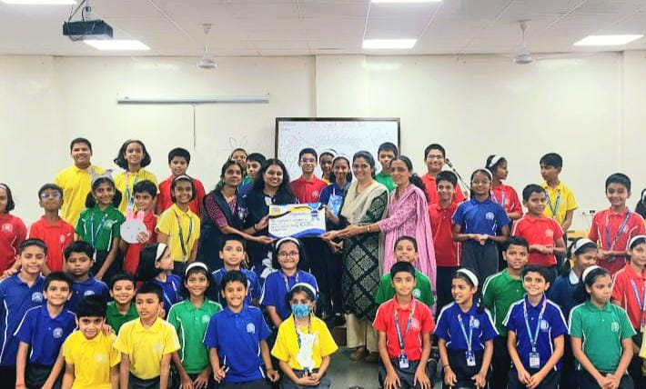
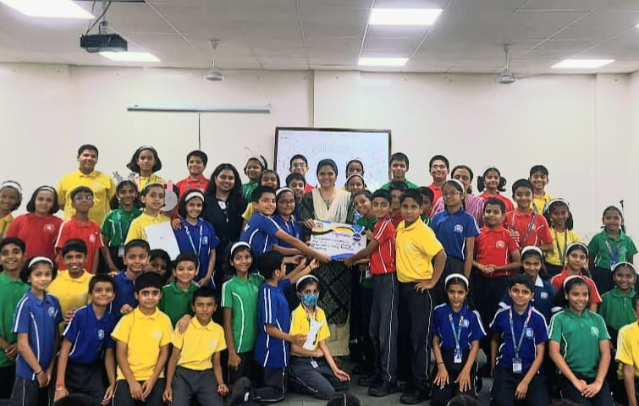
Poetry Recitation Competition – Winners Std 5

Slide 9
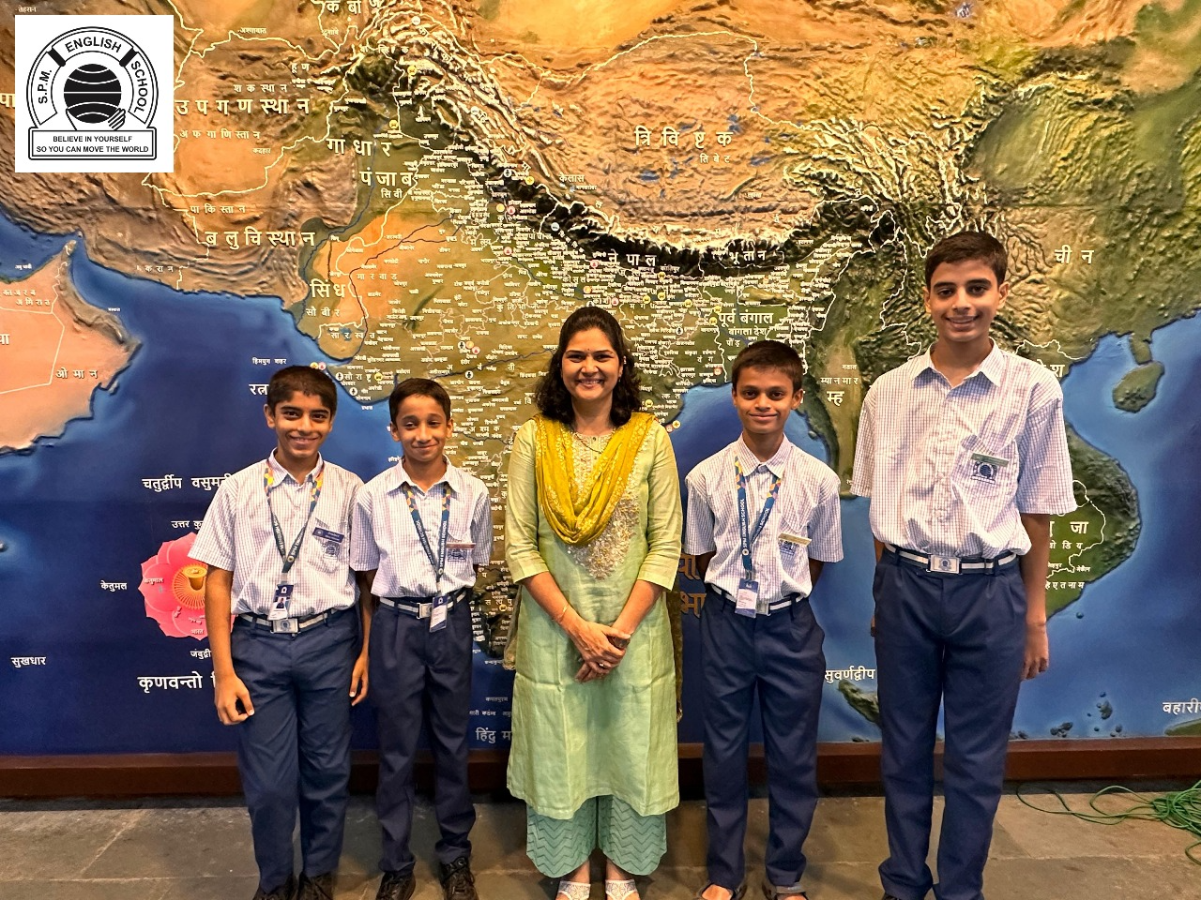
School Elections 2025-26
Prefects
Neil Kulkarni
Yash Soman
Sharan Kolle
Dhawal Londhe

Slide 10
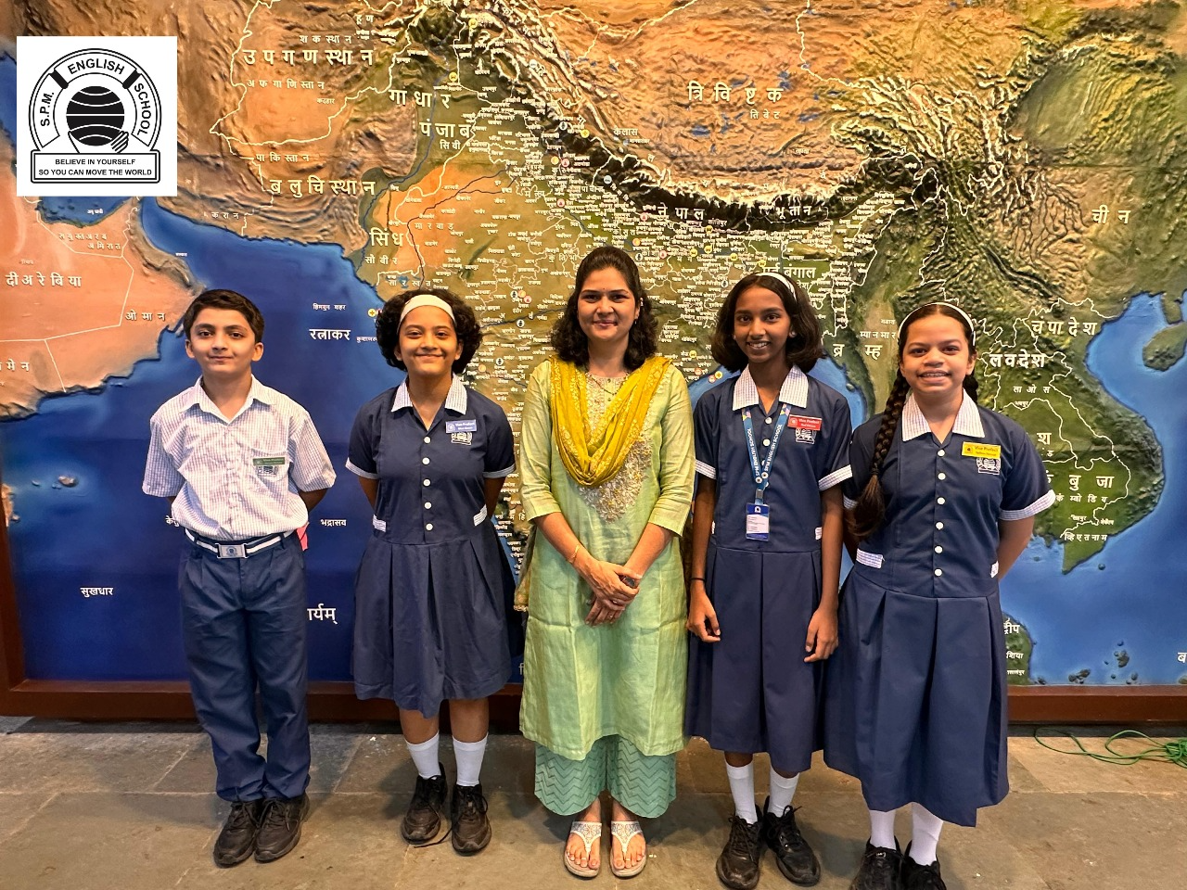
School Elections 2025-26
Vice- Prefects
Ayush Kulkarni,
Avani Desai
Anika Gajakas
Anuja Sahastrabuddhe

Slide 11
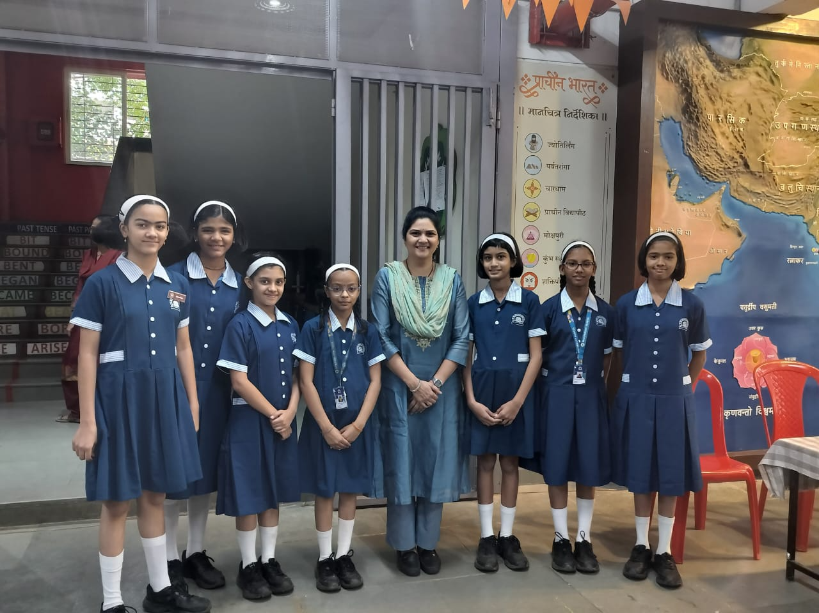
Std 5 : Scholarship Achievers

Slide 12
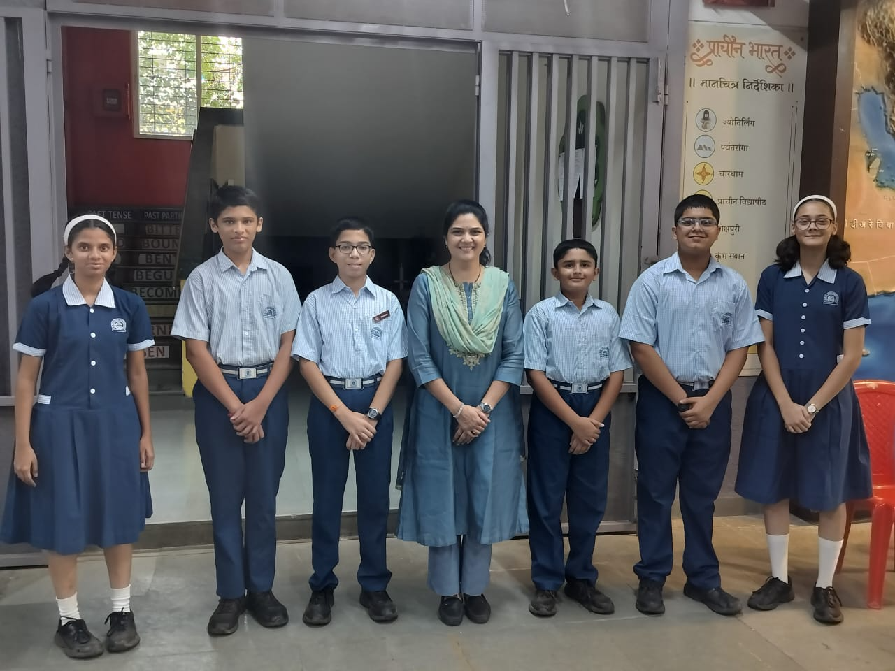
Std 8: Scholarship Achievers

Slide 13
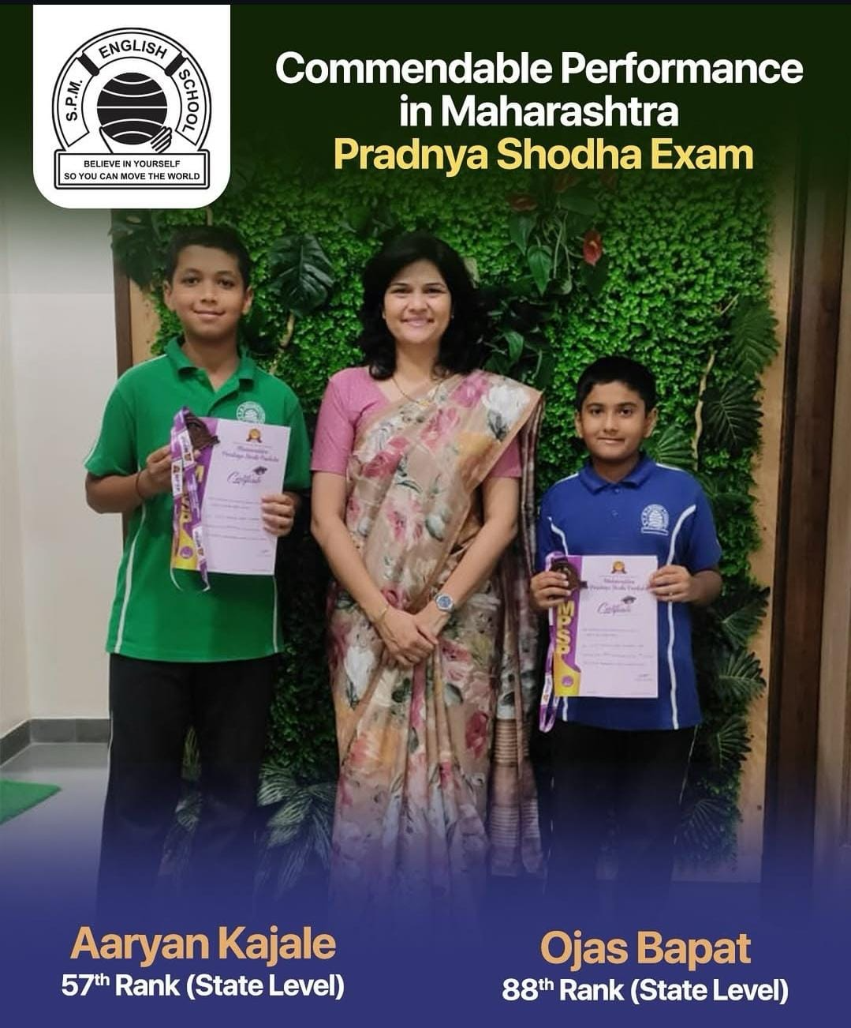

Slide 14
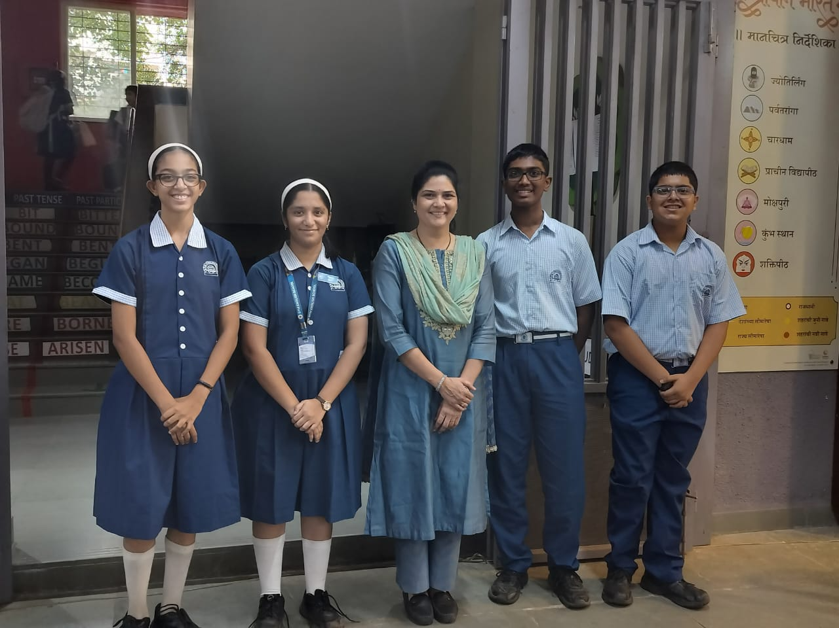
Commendable Performance in Maharashtra Talent Search Exam
Tanay Sheth (Std. 8) Consolation Prize
Sharva Deshpande (Std 9) Special Prize
Avanti Joshi and Aabha Joshi - Consolation Prizes.

Slide 15
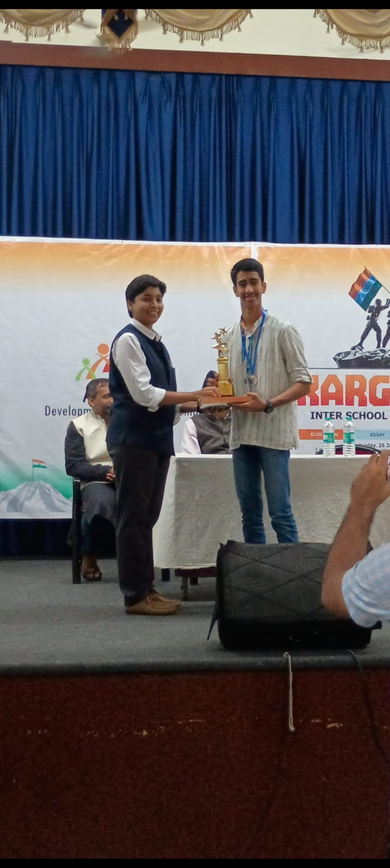
Marathi Essay Writing Competition organized by Aseem foundation.
Adit Joshi received second prize

Slide 16
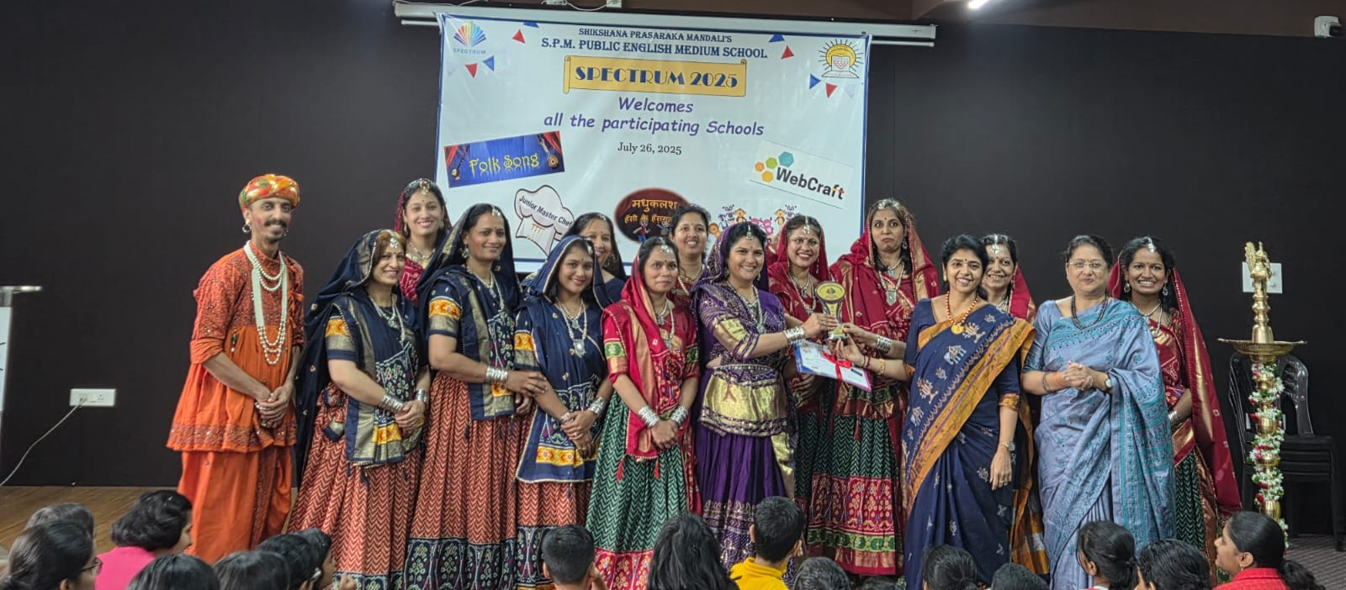
Teachers bag the 2nd Prize in Folk Song Competition

Slide 17

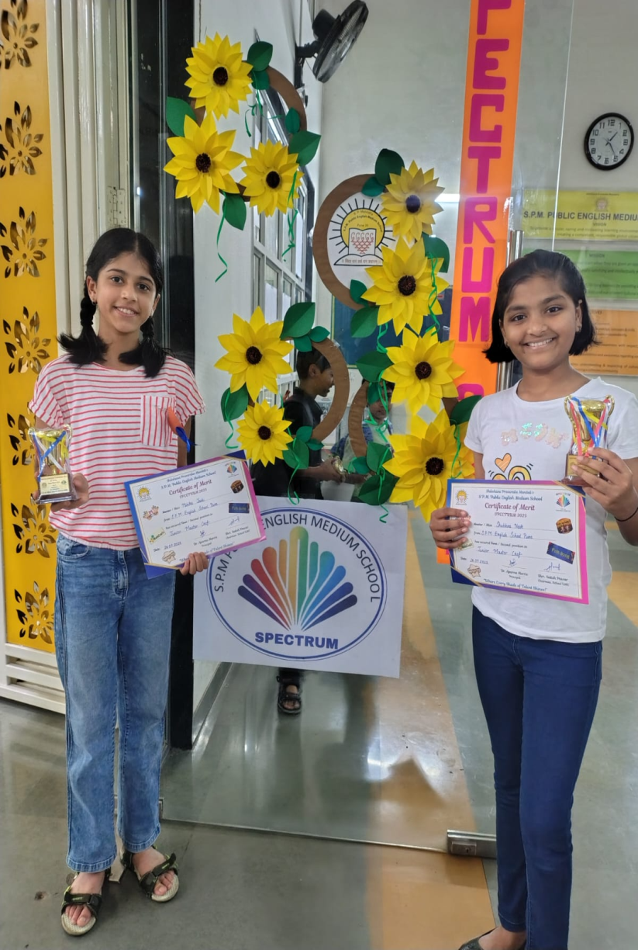
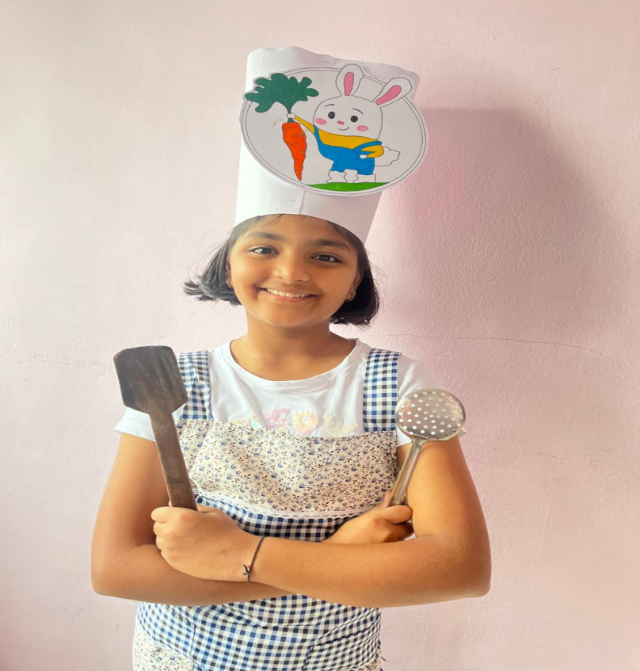
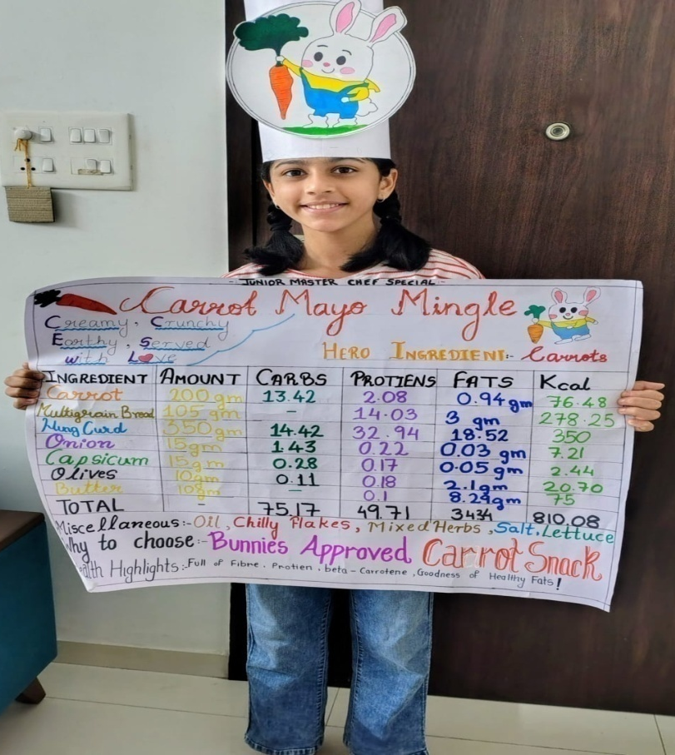
Shubhra Naik & Mihika Joshi - Secured the 2nd prize
Junior Master Chef Competition

Slide 18

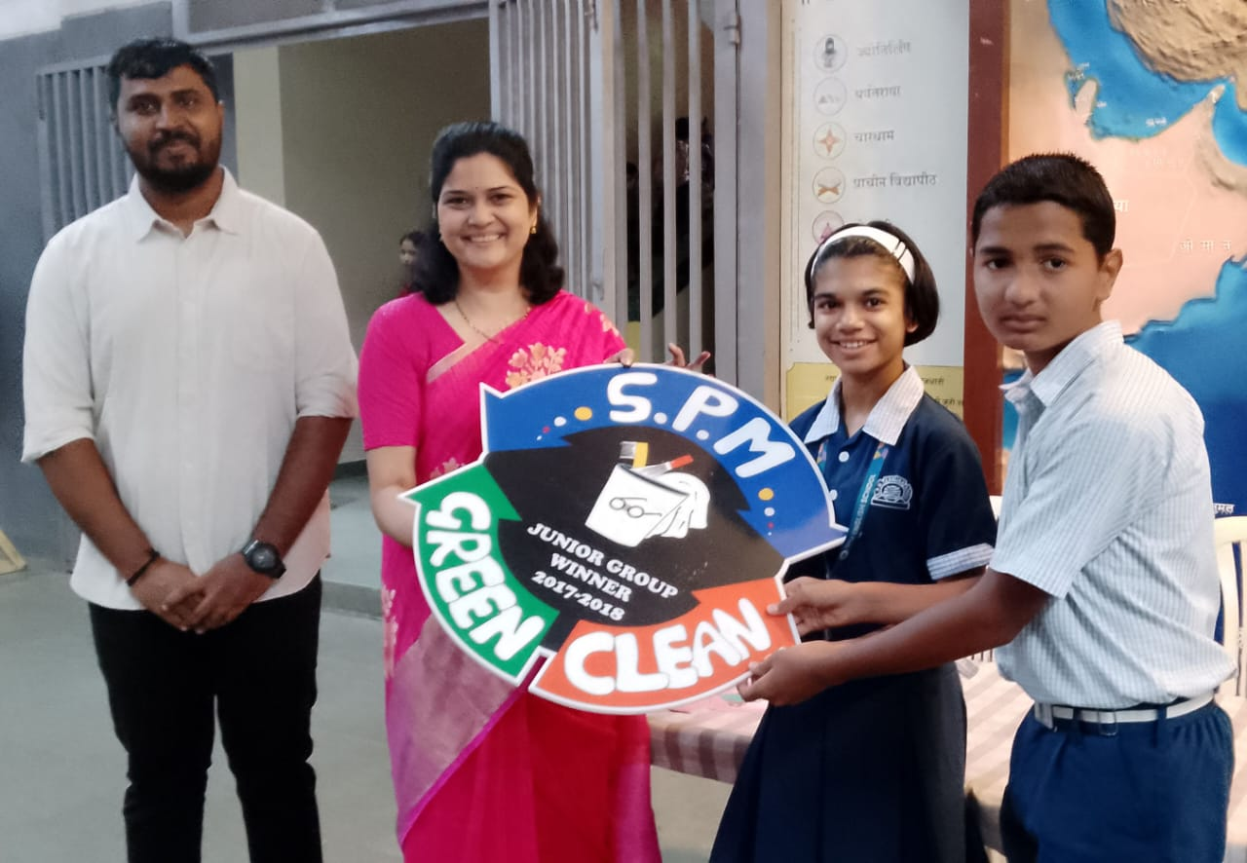
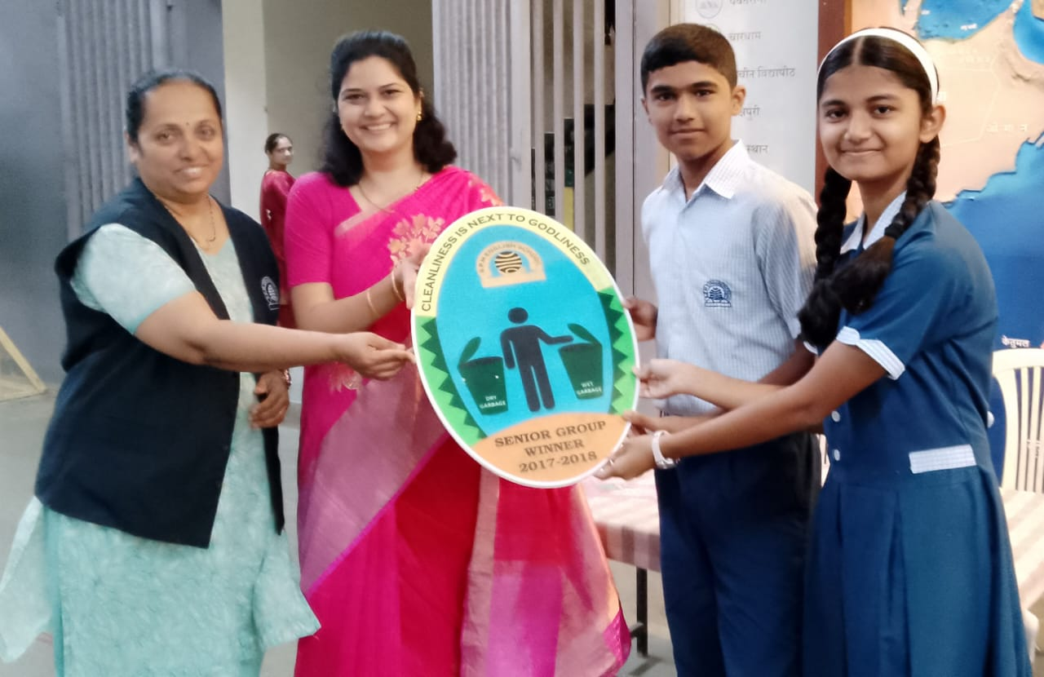
Cleanliness Trophy - Winners
Junior Group- Std 7 A
Senior Group- Std 9 C

Slide 19
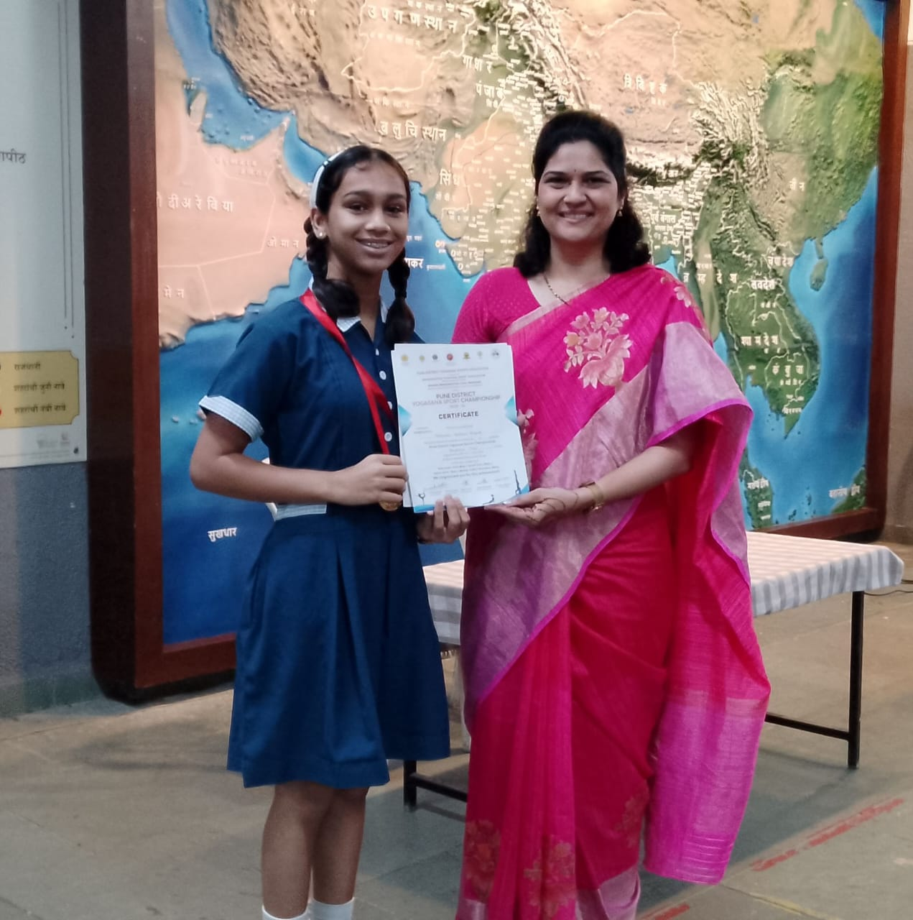


Yoga Champion- Tasmaee Argade

Slide 20
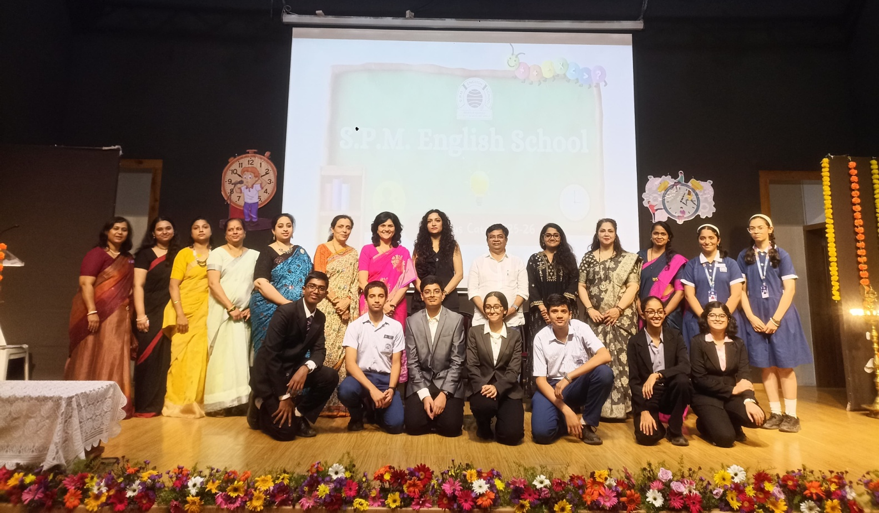
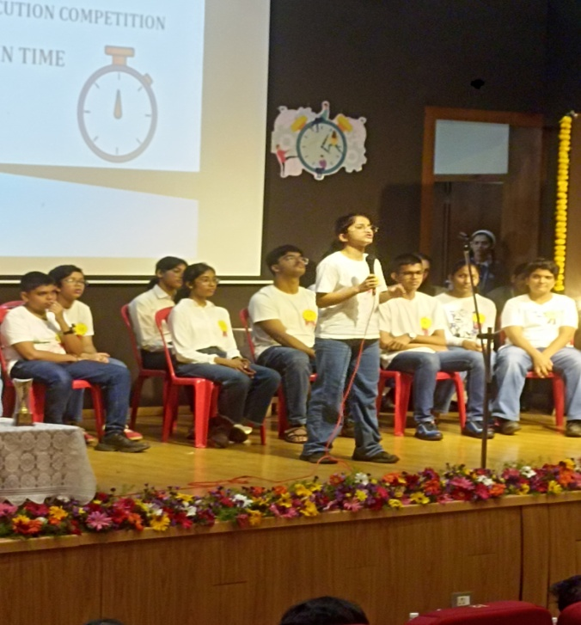
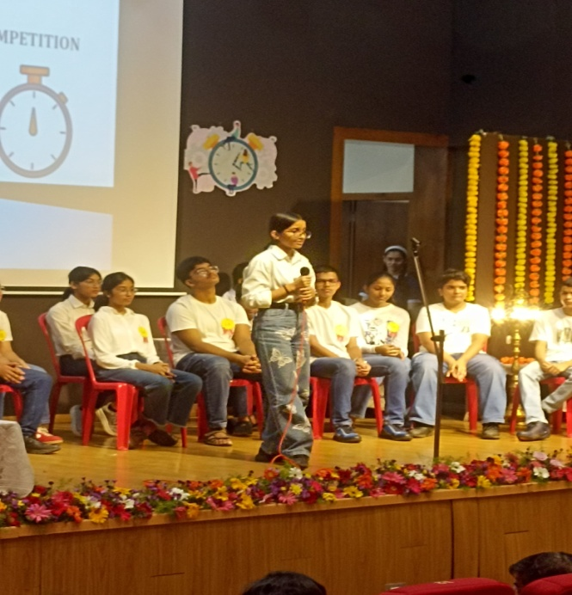
Marcus Cato Inter School Elocution Competition 2025-26

Slide 21
Thank You!

